Slide 1

Introduction to Natural Language Processing
BUS 243 F: Spring 2023
Yeabin Moon
Lecture 4

Slide 2
Review
What have we done?
Text representation
One-hot encoding
Bag-of-words representation
TF-IDF
Vector reasoning
Dot product
Cosine similarity
Text classification
Naïve Bayes approach

Slide 3
Problem of vocabulary
Frequency based representation has a large vocab
Zipf’s law: a few words are dominating, and most words (tokens) used once
Overfitting is inevitable
What are we assuming?
If the frequency of the tokens matters, why not the combinations of words?
If so, can we attach some meanings to them?

Slide 4
Goal of today
Study the latent semantic analysis (LSA)
Data Dimensionality reduction technique (PCA)
Understand the resulting topic vectors
Textbook is rather ambitious
Represent meaning?
Don’t be scared about the math

Slide 5
Simple Idea, eventually
We are going to reduce the size of the matrix
Entire vocabulary → a set of columns
Benefit?
Cost?
The terms “topic,” “semantic,” and “meaning” have used interchangeably in this chapter
I am not a fan ☹

Slide 6
Need to tone down
Frequency based approach fails to catch similar texts with different spellings
LSA technique tries to solve this problem by constructing topics vectors
However, “topic” has hardly intrinsic meaning
Need to discuss later

Slide 7
This is it!
… can you imagine how you might squash a TF-IDF vector with one million dimensions (terms) down to a vector with 200 or so dimensions (topics)? This is like identifying the right mix of primary colors to try to reproduce the paint color in your apartment so you can cover over those nail holes in your wall.

Slide 8
Thought experiment
Textbook shows the thought experiment in 4.1.3
This is a unicorn version of topic modeling
Keep in mind that this is what we want to achieve
See whether the PCA actually does this job
Let’s see the code

Slide 9
What are we doing?
We have 6X1 TF-IDF vector
We need to decide
The number of topics
Assign the weights corresponding to the topics

Slide 10
Human approach
Consider you are doing the two tasks manually
What’s you rule?
The number of topics
How about weights?
Probably you perform a semantic approach
How about a machine?

Slide 11
The relationships can be flipped
3X1 topic vector → 6X1 TF-IDF
Need to have 6X3 weights
Human approach: no problem
See the code and make sense of it
If we have the weights, possible to represent each words in terms of topics

Slide 12
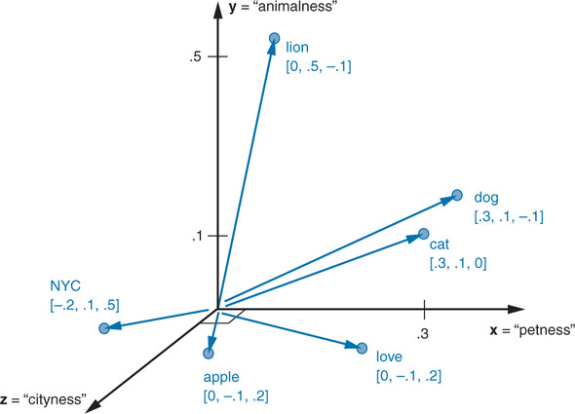
Represent each word in terms of topics

Slide 13
Wonderful topic vectors
Using three topics animal, pet, and NYC, we can represent all the words in our corpus, then.
In the thought experiment, you compressed six dimensions (TF-IDF normalized frequencies) into three dimensions (topics)
This subjective, labor-intensive approach to semantic analysis relies on human intuition and common sense to break down documents into topics
Topics mean really something here

Slide 14
Machine Approach
How could we deal with common sense and intuition?
That is, what’s the algorithm to generate topic vectors?
Textbook borrows the idea:
You shall know a word by the company it keeps
Well, not necessary true here
Let’s start with Linear discriminant analysis
Discuss whether we could find the topics

Slide 15
Linear discriminant analysis (LDA)
It is not a topic modeling
Remember what we need to do for the topic modeling
The number of topics
The corresponding weights
An LDA classifier is a supervised algorithm, so you do need labels for your document classes
The document classes should be given!
Supervised learning
Let’s see the code

Slide 16
What are we doing?
Still frequency matters
Calculate the TF-IDF
Assume each token plays a role for the particular class
Calculate the centroid of each token by class
Assume each word has some certain frequencies for the particular the class
Consider: tfidf_docs.dot(spam_centroid - ham_centroid)
Explain in words
E.g. what’s the meaning of 0 for a token?
Try to compare it with Naïve Bayes (optional: see the code)

Slide 17
Latent semantic analysis
LDA is not very interesting in terms of a topic modeling
We are wondering how machines understand a topic!
Remember human intuition and common sense?
Let’s pause here and explore the concept of PCA
PCA is essentially the Latent semantic analysis

Slide 18
Change the order
Many students feel overwhelmed on this subject
I will guide you
the PCA code first
NLP application
And then, explanation
Let’s see the code

Slide 19
Principal Component Analysis
Do not look at the name of the columns yet
We have 4,837 sms spam-labeled messages
The size of vocab is 9,232
Apply PCA with 16 PCs
Explain about 10 % variance of the data

Slide 20
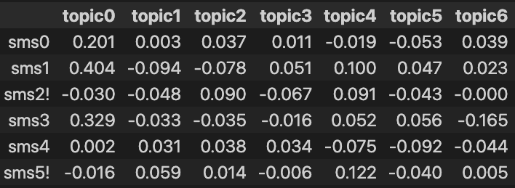
See the values

Slide 21
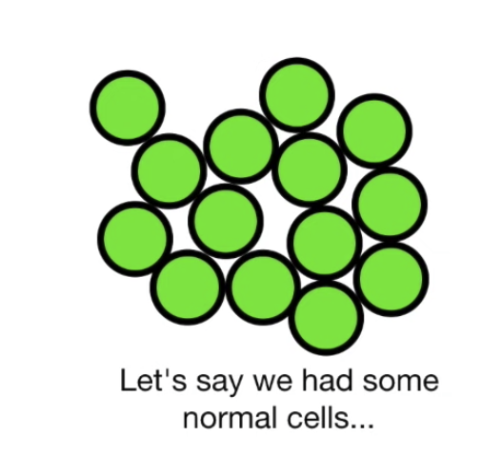
Now let’s find out the meaning of PCA

Slide 22
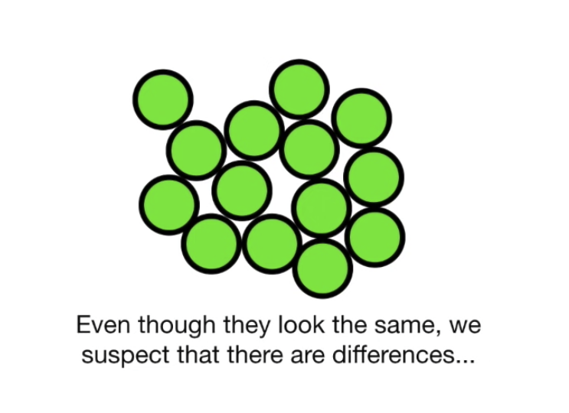

Slide 23
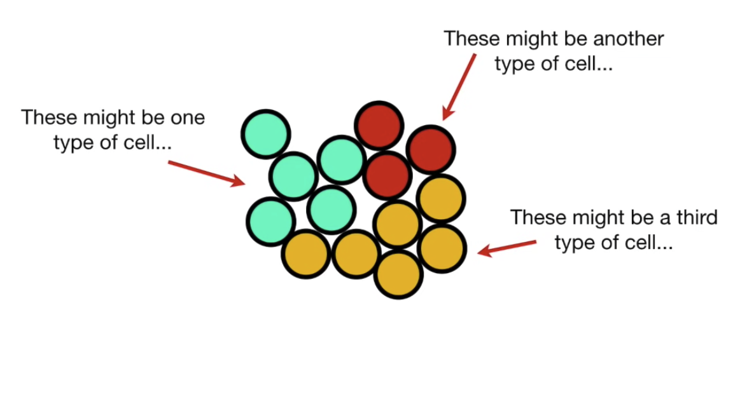
We can’t observe the differences from the outside

Slide 24
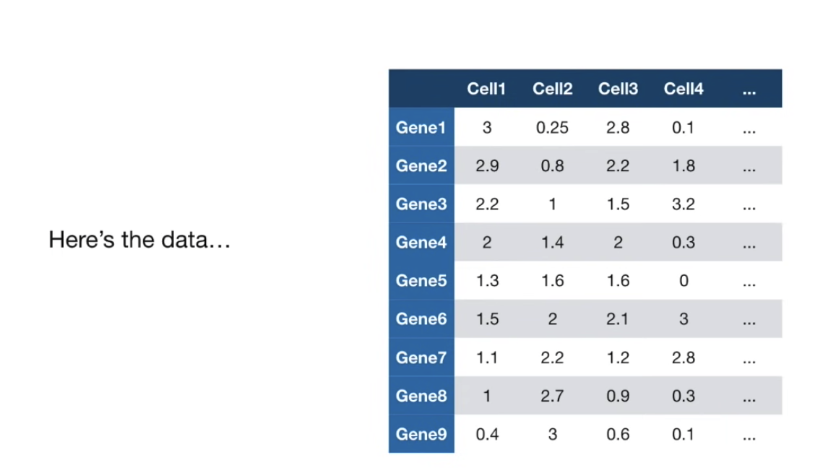

Slide 25
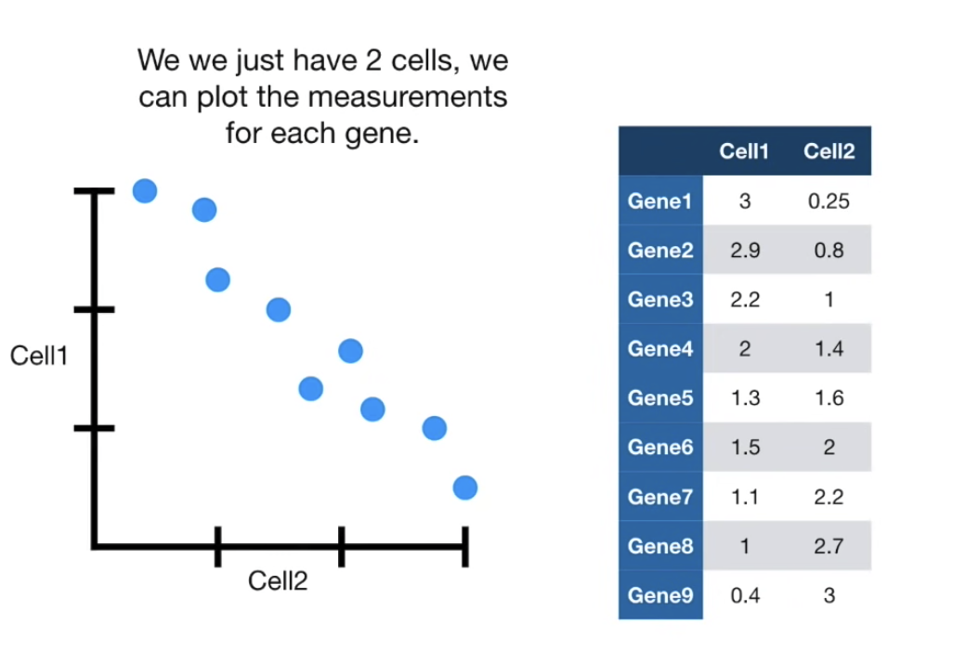

Slide 26
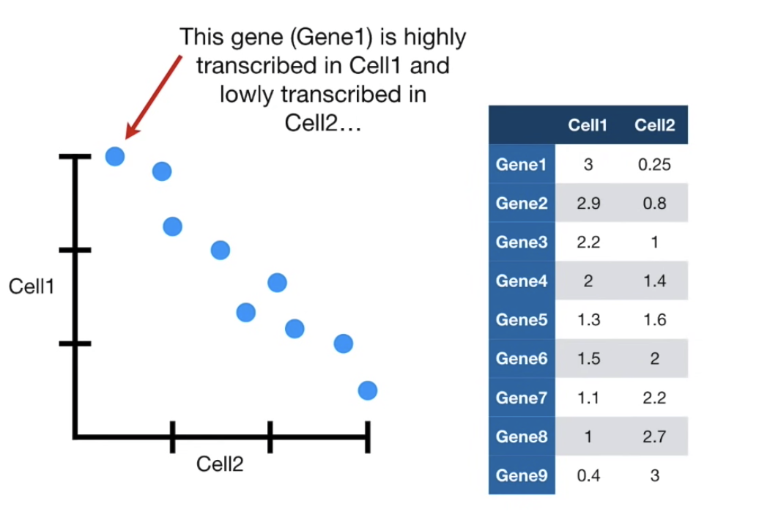

Slide 27
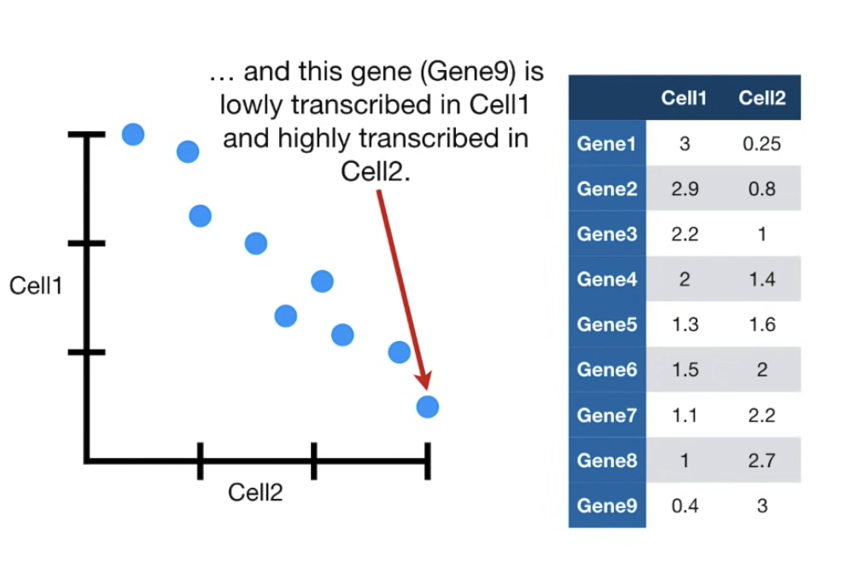

Slide 28
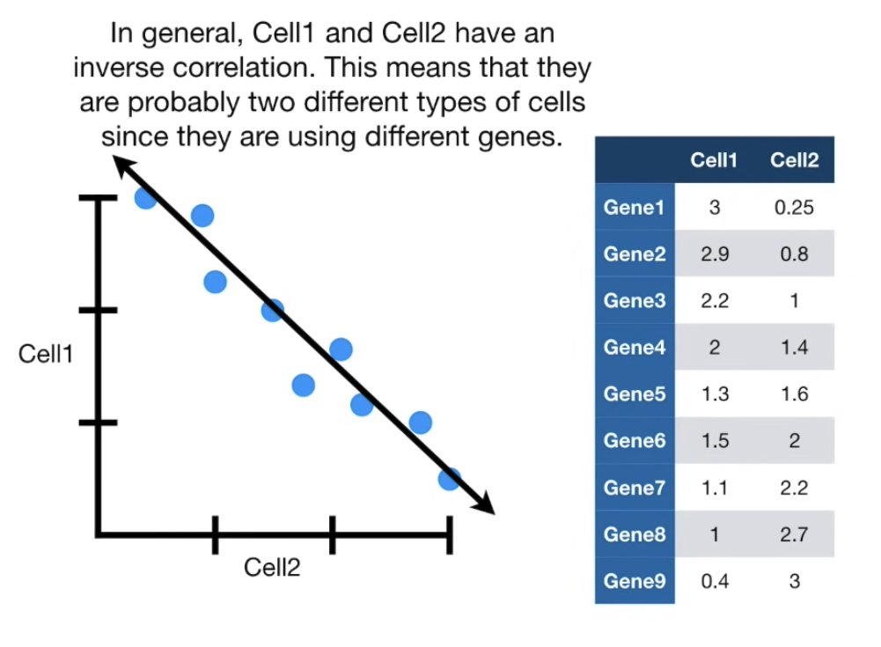

Slide 29
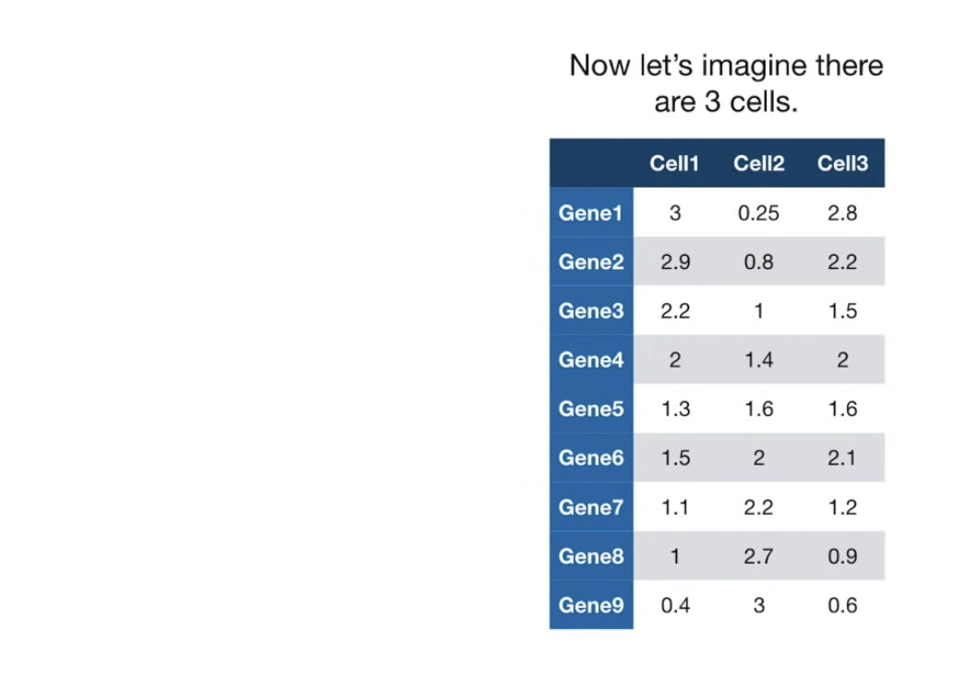

Slide 30
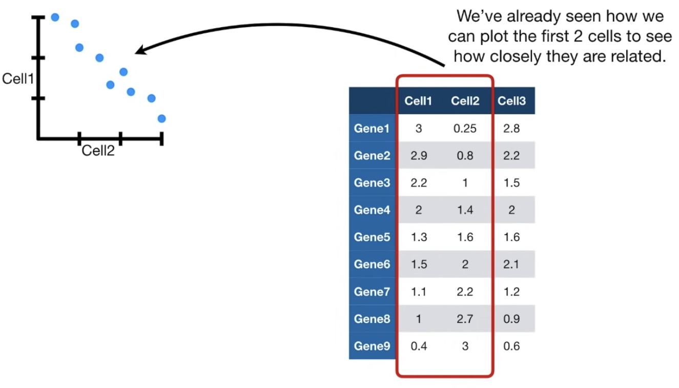

Slide 31
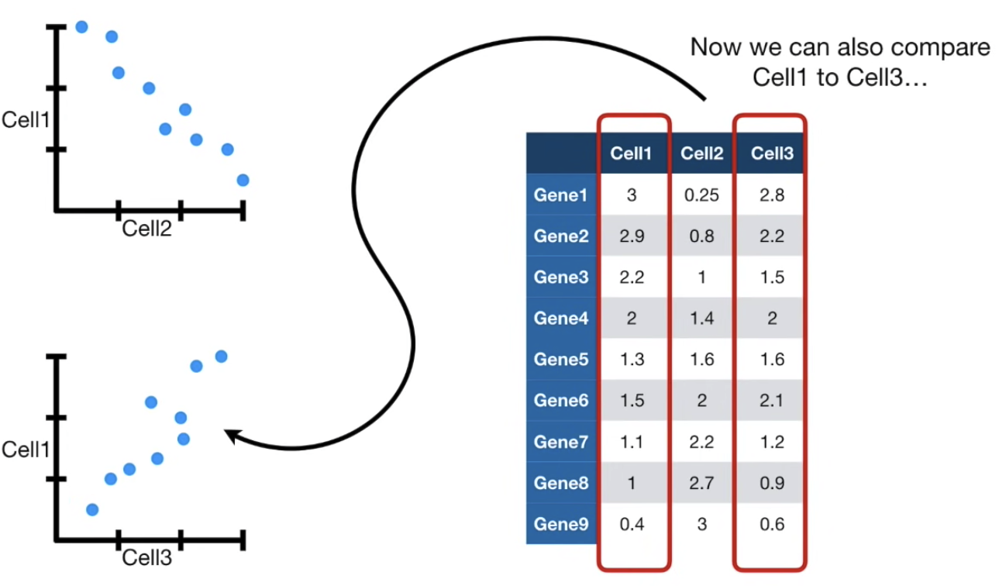

Slide 32
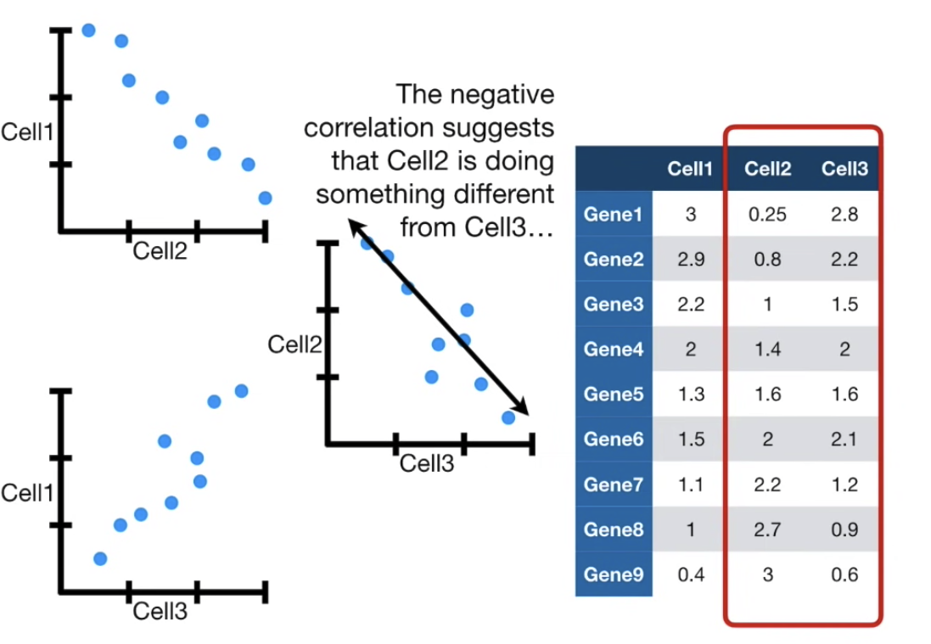

Slide 33
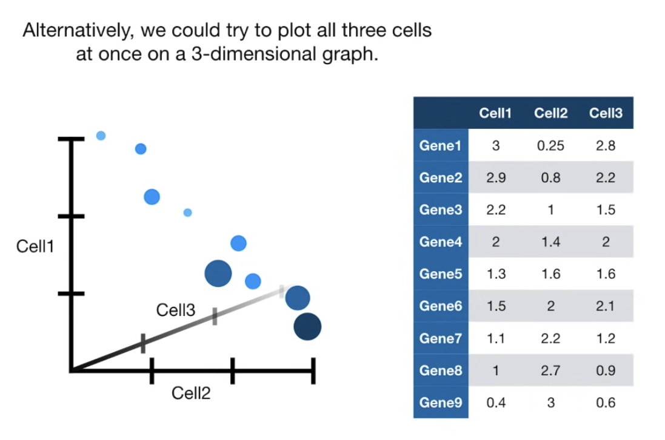

Slide 34
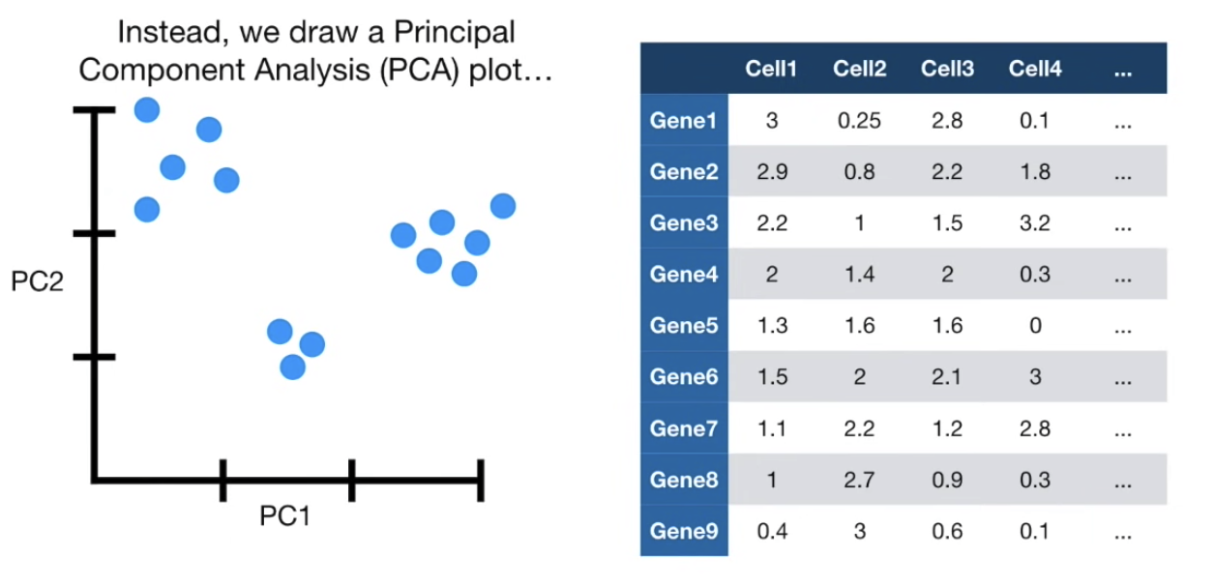
But what do we do when we have 4 or more cells?

Slide 35
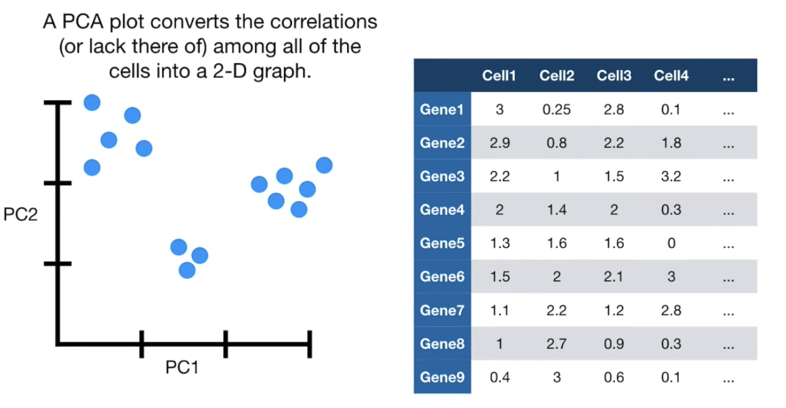
Cells that are highly correlated cluster together

Slide 36
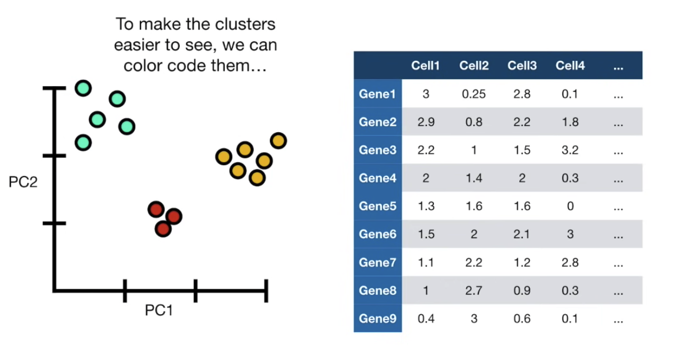

Slide 37
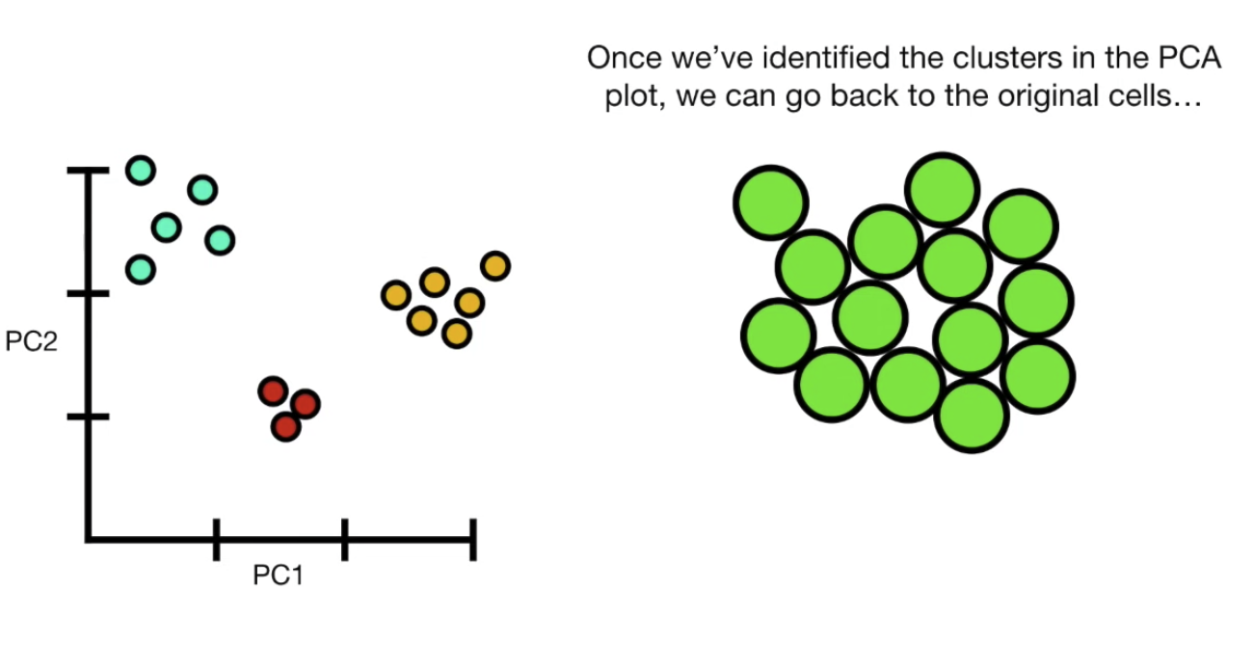

Slide 38
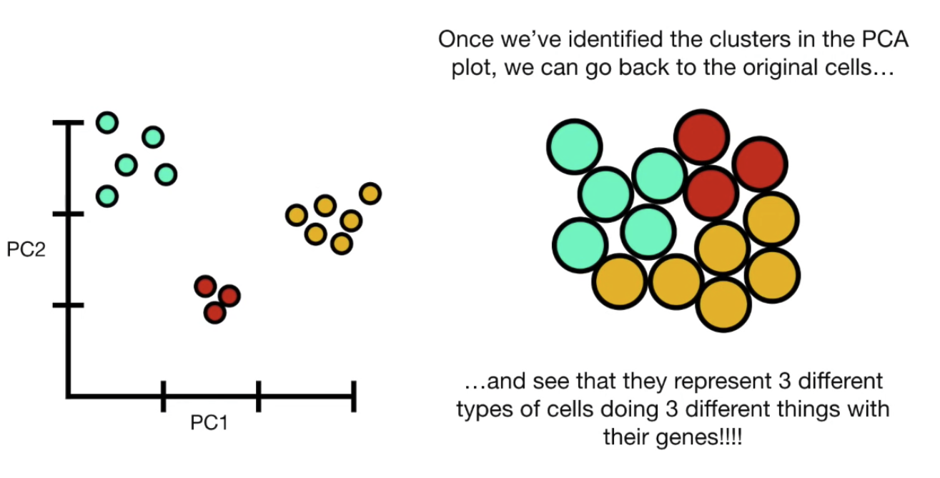

Slide 39
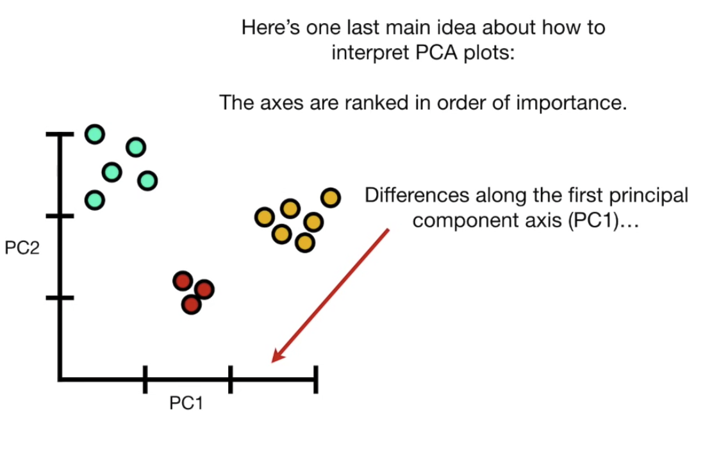

Slide 40
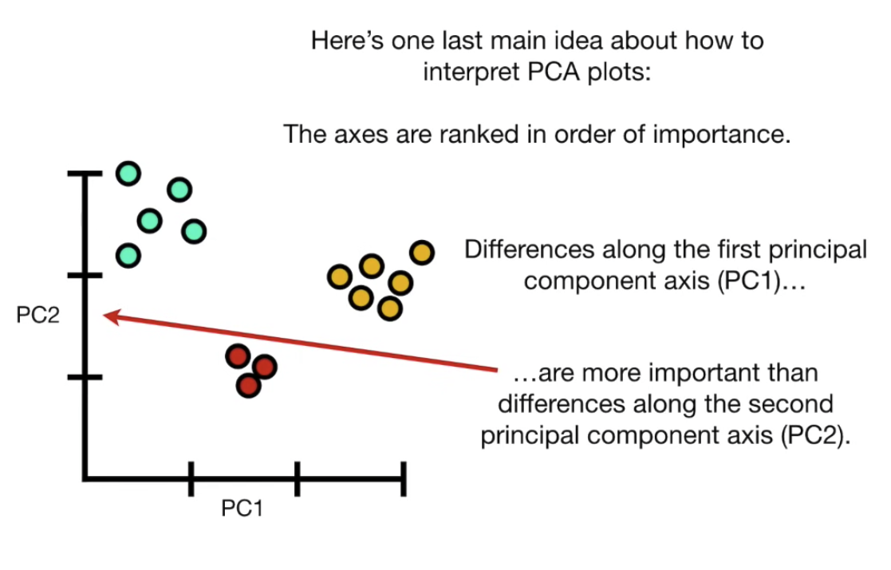

Slide 41
PCA and Topic modeling
Selecting principal components is not equivalent to selecting features
while selecting principal components may lead to a reduction in the dimensionality of the data, it may not necessarily identify the most relevant subset of features
Selecting principal components involves identifying the most important patterns or directions of variation in the data
These components are linear combinations of the original features
We will consider whether the linear combinations of the words would imply the topics

Slide 42
PCA in math
PCA algorithm first identifies the hyperplane that lies closet to the data and then it projects the data onto it
As a result, the corresponding data preserves the maximum variance of the original data

Slide 43
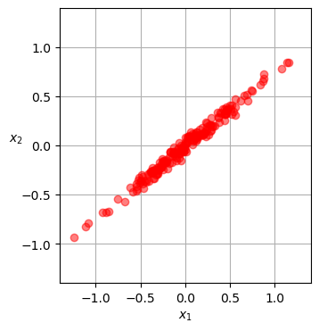
Figure out PCs
We have the following data
Need to find the closet hyperplane to data
It is just a line
The projection on the the line

Slide 44
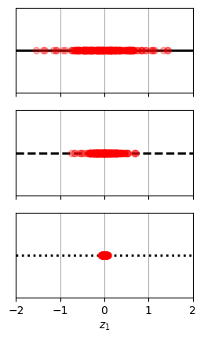
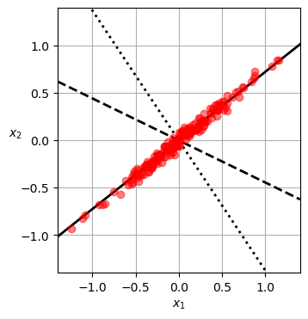
Projection on the 3 hyperplanes

Slide 45
Principal Components
PCA identifies the solid line earlier
Data has two features: x1 and x2
PCA identifies the axis accounting for the largest amount of variance in data
It also find the dotted line, orthogonal to the first one
Accounts for the largest amount of the remaining variance
It uses a standard matrix factorization technique called singular value decomposition (SVD)

Slide 46
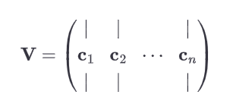
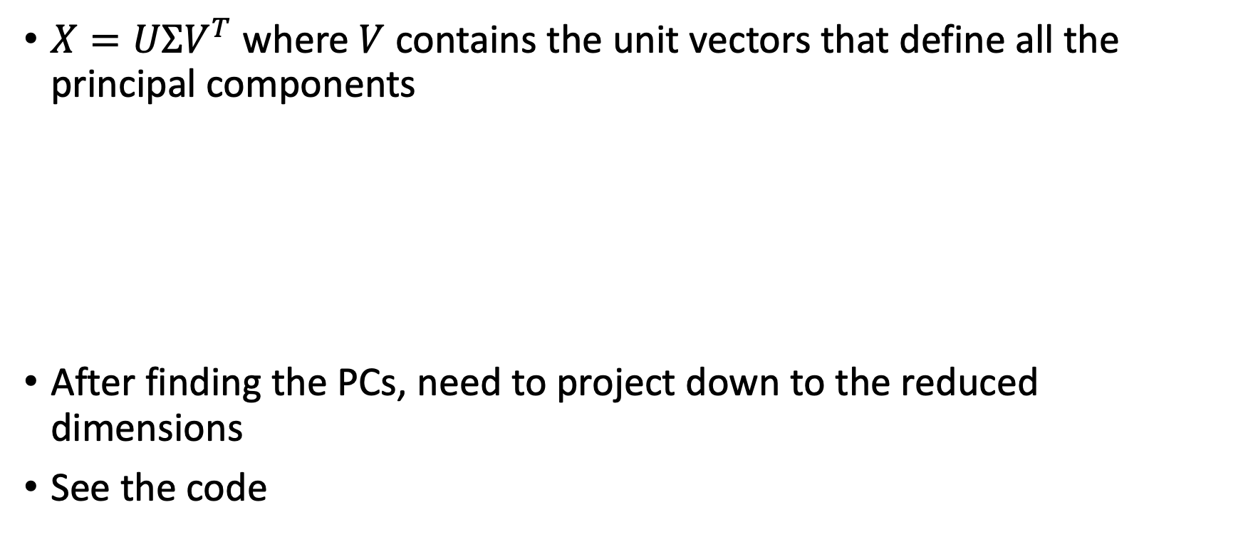
SVD
$X=UΣV^{T}$ where $V$ contains the unit vectors that define all the principal components
After finding the PCs, need to project down to the reduced dimensions
See the code

